Slide 1
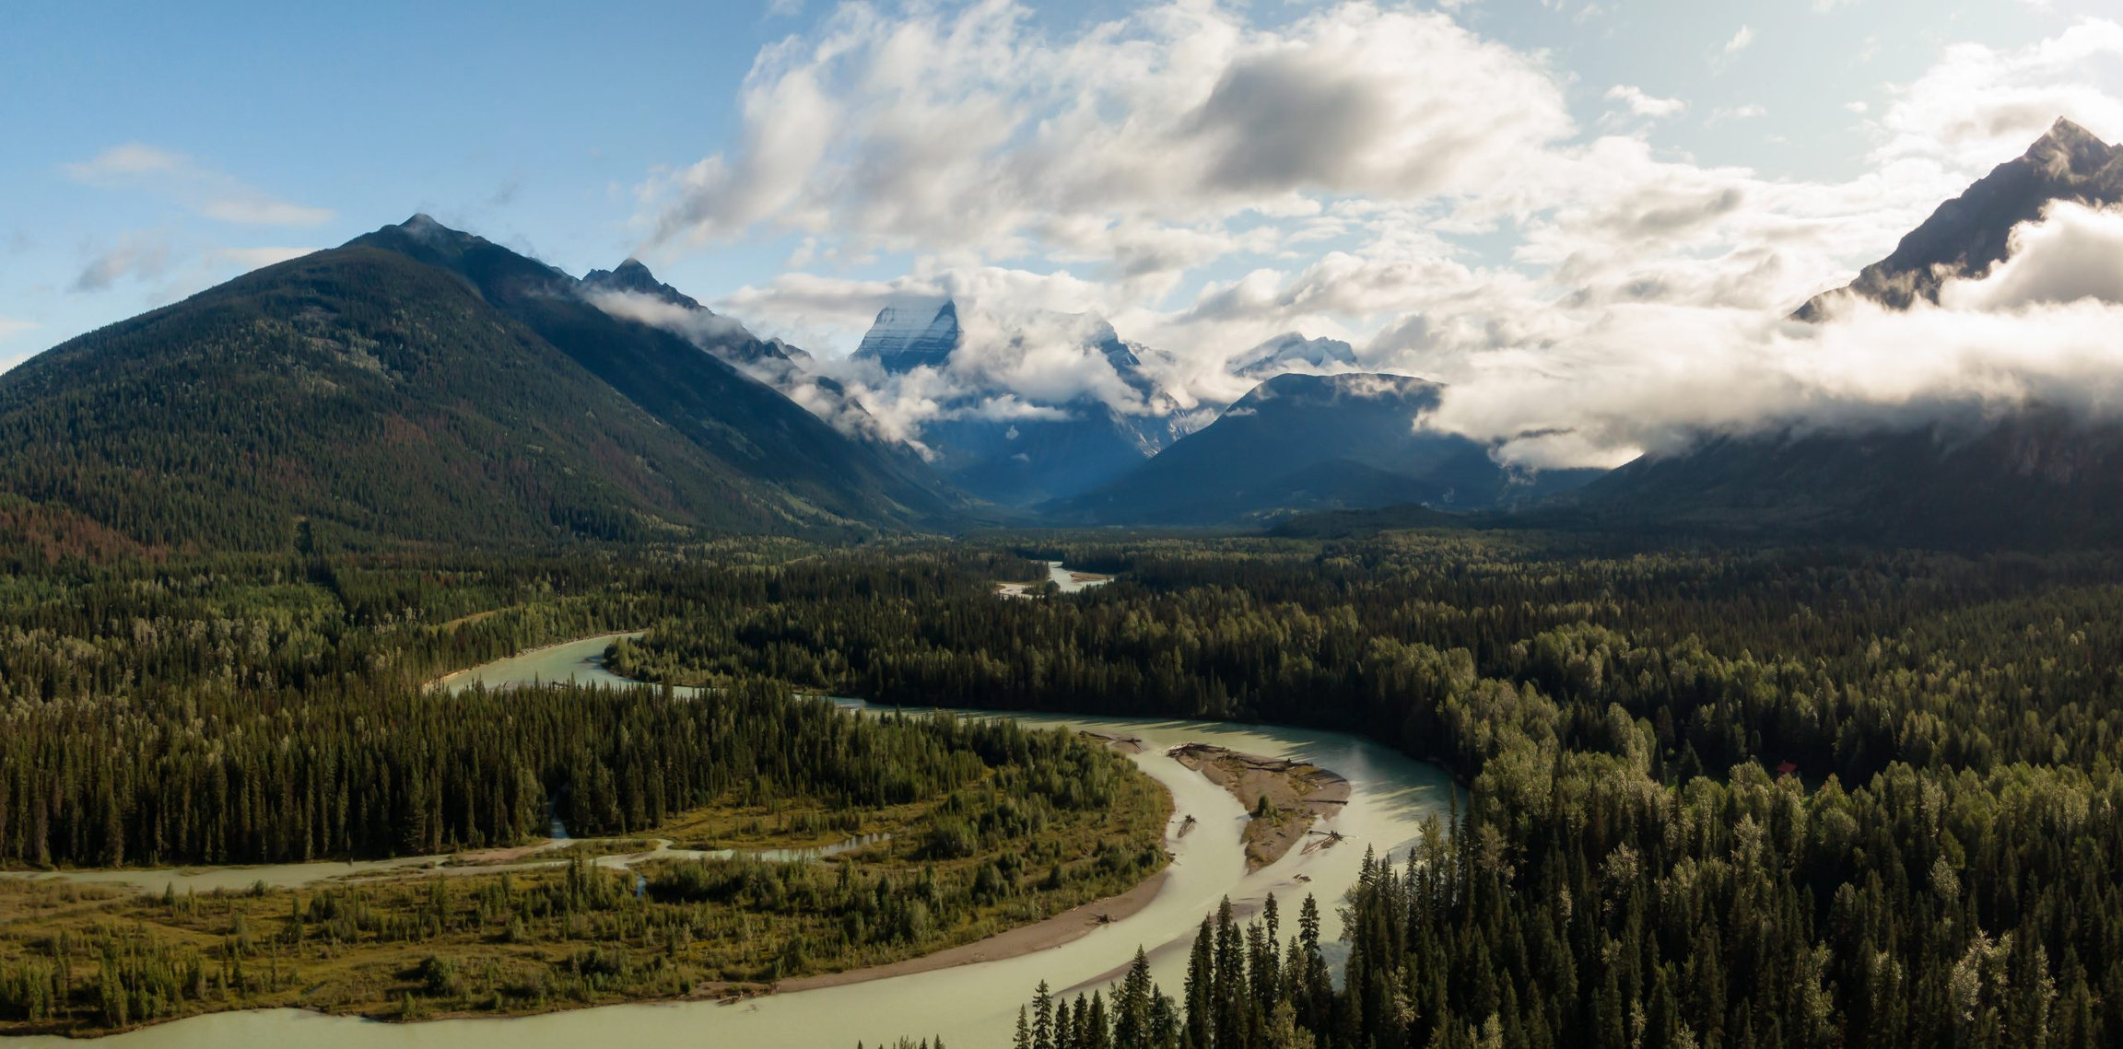

CSE: OMGA | OTCQB: OMGPF |
FSE: Q0F
An Overlooked Gold Discovery
In Toodoggone’s Golden Era
Corporate Presentation​
June 2026​

Slide 2
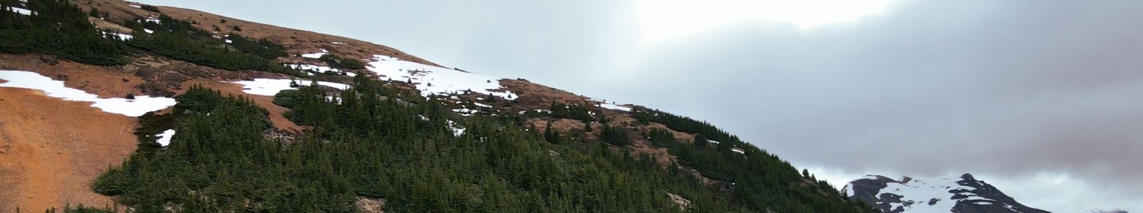

Cautionary Statement​
Certain statements contained in this presentation constitute forward-looking statements. These statements relate to future events or the Corporation's future performance, business prospects or opportunities. All statements other than statements of historical fact may be forward-looking statements. Forward-looking statements are often, but not always, identified by the use words such as "seek", "anticipate", "plan", "continue", "estimate", "expect, "may", "will", "project", "predict", "potential", "targeting", "intend", "could", "might", "should", "believe" and similar expressions. These statements involve known and unknown risks, uncertainties and other factors that may cause actual results or events to differ materially from those anticipated in such forward-looking statements. The Corporation believes that the expectations reflected in those forward-looking statements are reasonable, but no assurance can be given that these expectations will prove to be correct and such forward-looking statements should not be unduly relied upon.
These statements speak only as of the date specified. The Corporation does not intend, and does not assume any obligation, to update these forward-looking statements. These forward-looking statements involve risks and uncertainties relating to, among other things, results of exploration activities, the Corporation's limited experience with development-stage mining operations, uninsured risks, regulatory changes, defects in title, availability of materials and equipment, timeliness of government approvals, changes in commodity and, particularly, gold prices, actual performance of facilities, equipment and processes relative to specifications and expectations and anticipated environmental impacts on operations. Actual results may differ materially from those expressed or implied by such forward-looking statements.
Qualified Person
The technical information with the Company’s website and presentations have been reviewed and approved by Rob L’Heureux P.Geol., a Director of Omega Pacific, a Qualified Person as defined by NI 43-101 standards, responsible for the scientific and technical information contained herein.
2

Slide 3
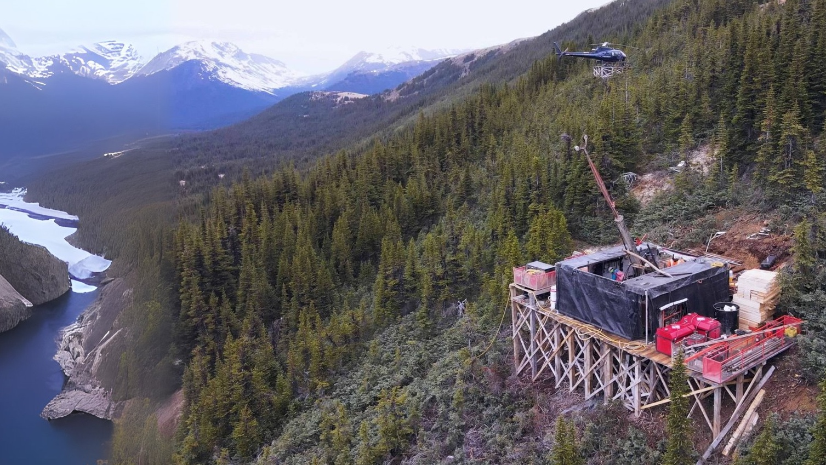
Right Team, Right Place, Right Time
Team with Proven Track Record
Technically driven team, $1B+ raised, 10M+ ounces of gold discovered across three continents.
Toodoggone District Expertise
A record of exploration success and expertise in the district. Our directors were instrumental in founding and advancement of Thesis Gold’s Lawyers-Ranch Project (2.27 Moz Au Indicated & 5.45 Moz Au Inferred).
Quality Asset
Bulk tonnage gold discovery high grade zones. Multimillion ounce potential and additional Au-Cu opportunities. Cost effective exploration strategy.
Capital Structure
Attractive share structure with significant management ownership.
3

Slide 4




Leadership
Jason Leikam
CEO, Director
25 years experience in marketing, including serving as officer, director and founder of several junior exploration & development and cleantech companies.
Mark Minckler
CFO, Director
30 years of experience in accounting and finance,
initially working in public practice for 10 years before moving to the private sector
as a partner in a property development company.
John Williamson
Director (P.Geol.)
Founder & Principal of the Metals Group. Over 35 years experience operating global exploration and mining companies. Recognized several times for excellence by being named to the TSX Venture50. Founder of Benchmark Metals/Thesis Gold.
Rob L’Heureux
Director (M.Sc., P.Geol.)
25 years of global mineral exploration experience, managing exploration projects from grassroots to resource definition of several multimillion ounce gold deposits, including the Lawyers-Ranch project in the Toodoggone.
4

Slide 5
Capital Structure
Shares | 49,587,883
Warrants | 10,570,788
Options | 3,195,000
Fully Diluted | 63,353,671
MCAP | $8.4M
35%
30%
30%
5%
Management
Retail
Affiliates
Funds
5

Slide 6
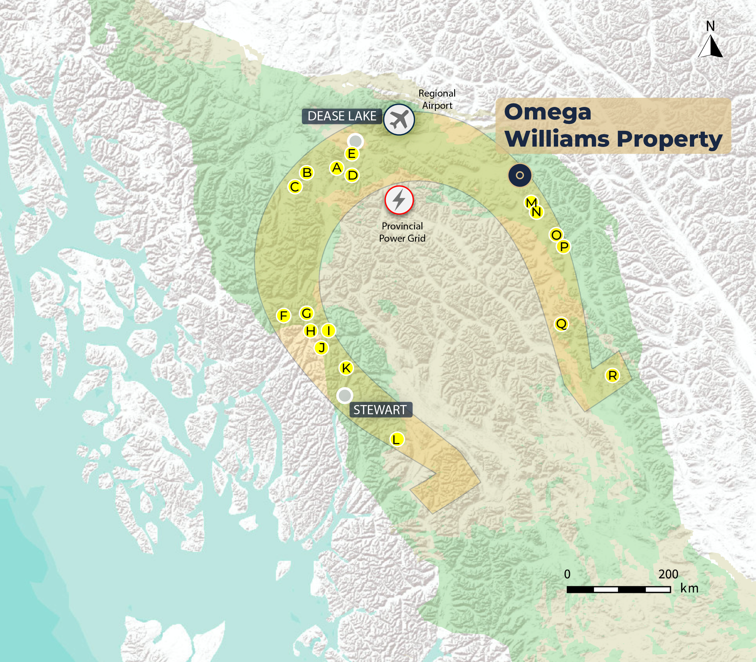
BC's Golden Horseshoe
  “One of the most attractive jurisdictions in the world” – Head External Relations, Newmont North America (CBC Nov 6, 2025)
Newmont | Saddle North
Teck | Schaft
Teck & Newmont | Galore Creek
Newmont | Red Chris
Torr Metals | Latham
Seabridge | Bronson
Skeena | Eskay
Seabridge Gold | KSM
Newmont | Brucejack
Ascot | Premier
Ascot | Red Mountain
Anyox
Thesis | Ranch
Thesis | Lawyers
Amarc | Joy
Centerra | Kemess
NorthWest Copper | Lorraine
Centerra | Mt. Milligan
Geology ​
  A major trend for epithermal and porphyry deposits
  The Stikine Terrane spans the Golden Triangle and the Toodoggone District, resembling a horseshoe shape
Attractiveness
  Increasing investment across the Golden Horseshoe
  Driving discovery and project advancement.
  Tier One jurisdiction with multilateral support for resource development.
Skitine Terrane
Bowser Basin
6

Slide 7
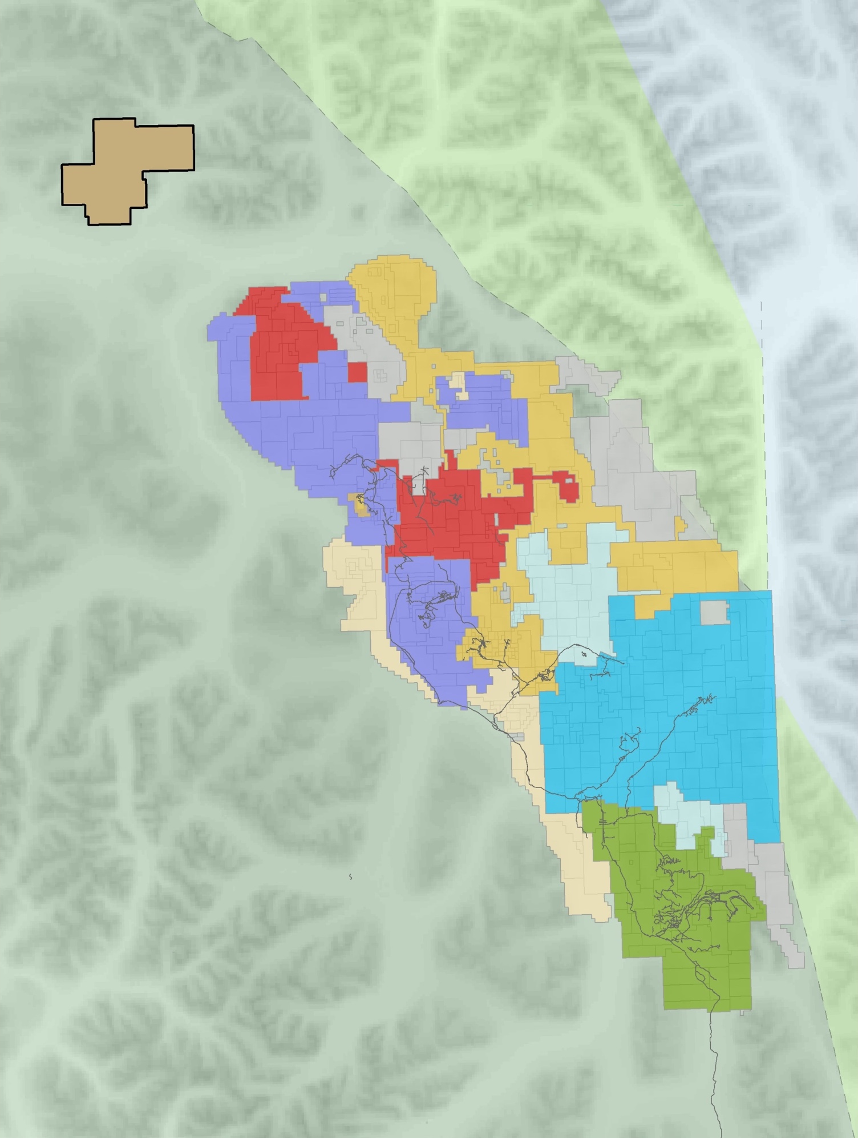










The Toodoggone
Williams Property
Proven Prospectivity
  ~10M oz Au discovered over last 8 years
  Major trend for epithermal and porphyry deposits
GIC
T-Bill
EVERGOLD
GOLDEN LION
Discovery
  Several gold, copper-gold discoveries in 2024/2025, including Lawyers-Ranch, JD, Aurora, and Williams
  .
STARFIRE MINERALS
PORPHYRY PEARL
THEORY
LAWYERS
Attractive Region
  Strategic investment from mid-tier and major mining companies
GOLDEN STRANGER
Sturdee Airstrip
PIL
Potential
  Abundant mineral endowment and exploration upside
  … including Williams Property
All-Season Road
BAKER
AuRORA
Hydroelectric Power Grid
KEMESS SOUTH
7

Slide 8
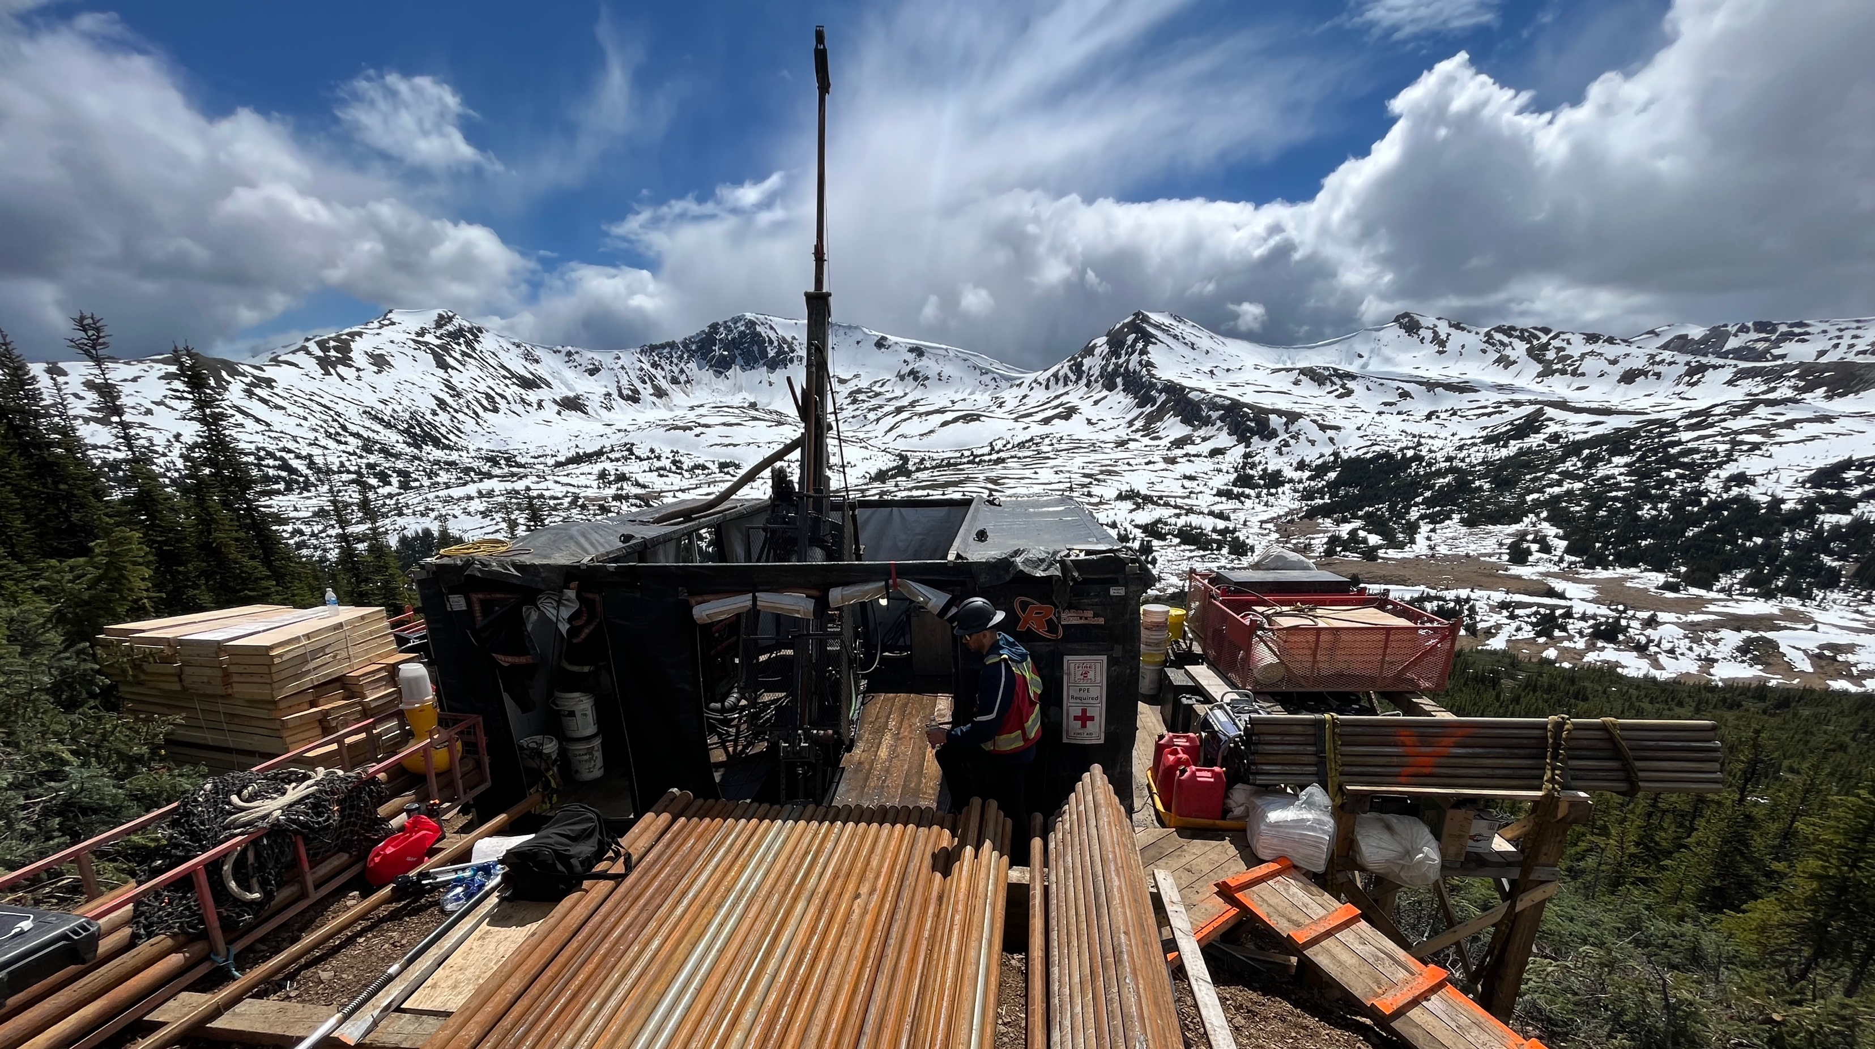
Williams Property
Snapshot:
2024 Bulk Tonnage Gold Discovery with high grade zones
Exploration Permits In Place
3 Key Prospects
Under Explored
11,489 Ha
8

Slide 9
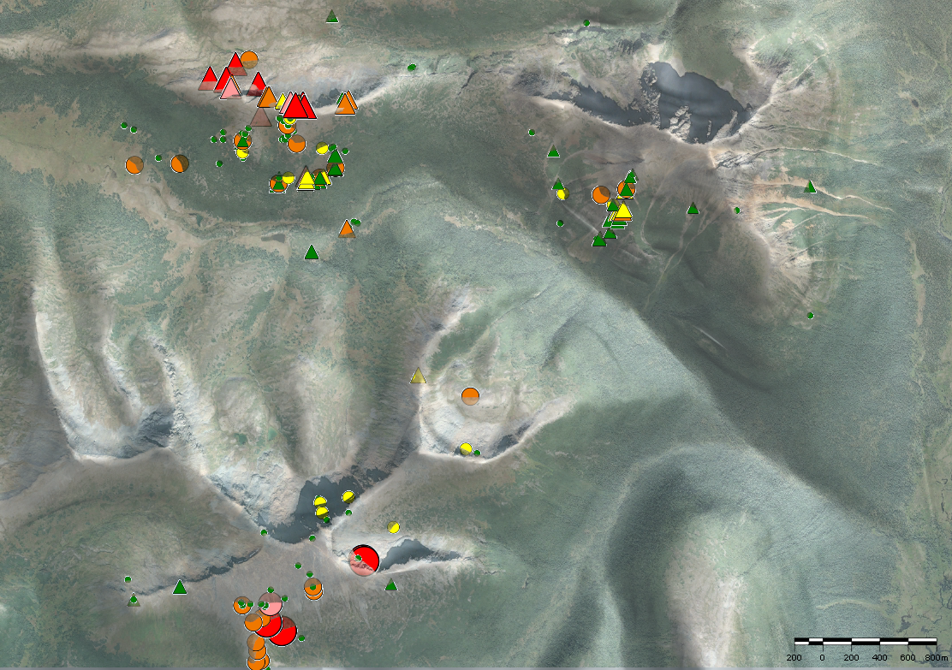

Three Key Targets
Three Distinct mineralization styles across 21 sq km
GIC
2024 drilling discovery
  1.69 g/t Au over 104m (incl. 6.22 g/t Au
  over 18.98m)
  2.16 g/t Au over 96.9m (incl. 4.60 g/t Au over 10.50m
High grade orogenic style gold mineralization
Multi million-ounce potential
1.8 km gold target
ROI
2.5 km east of GIC
Intrusion related porphyry style anomalies
5 km Geophysical Au/Cu-Au signature
T-Bill
3 km x 2.5 km epithermal gold target
Historic drilling: 1.38 g/t Au over 41.57 m (WM21-07)
Historic surface sampling incl. 13-22 g/t Au
Only 300 m of target explored
GIC
ROI
Au Rock Grab Samples (ppm)
Cu Rock Grab Samples (wt %)
< 0.01 (not shown)
0.1-0.5
0.5-1.0
1.0-5.0
5.0-10
> 10
< 0.01 (not shown)
0.01-0.05
0.05-0.10
0.10-0.50
0.50-1.00
> 1.00
T-Bill
9

Slide 10
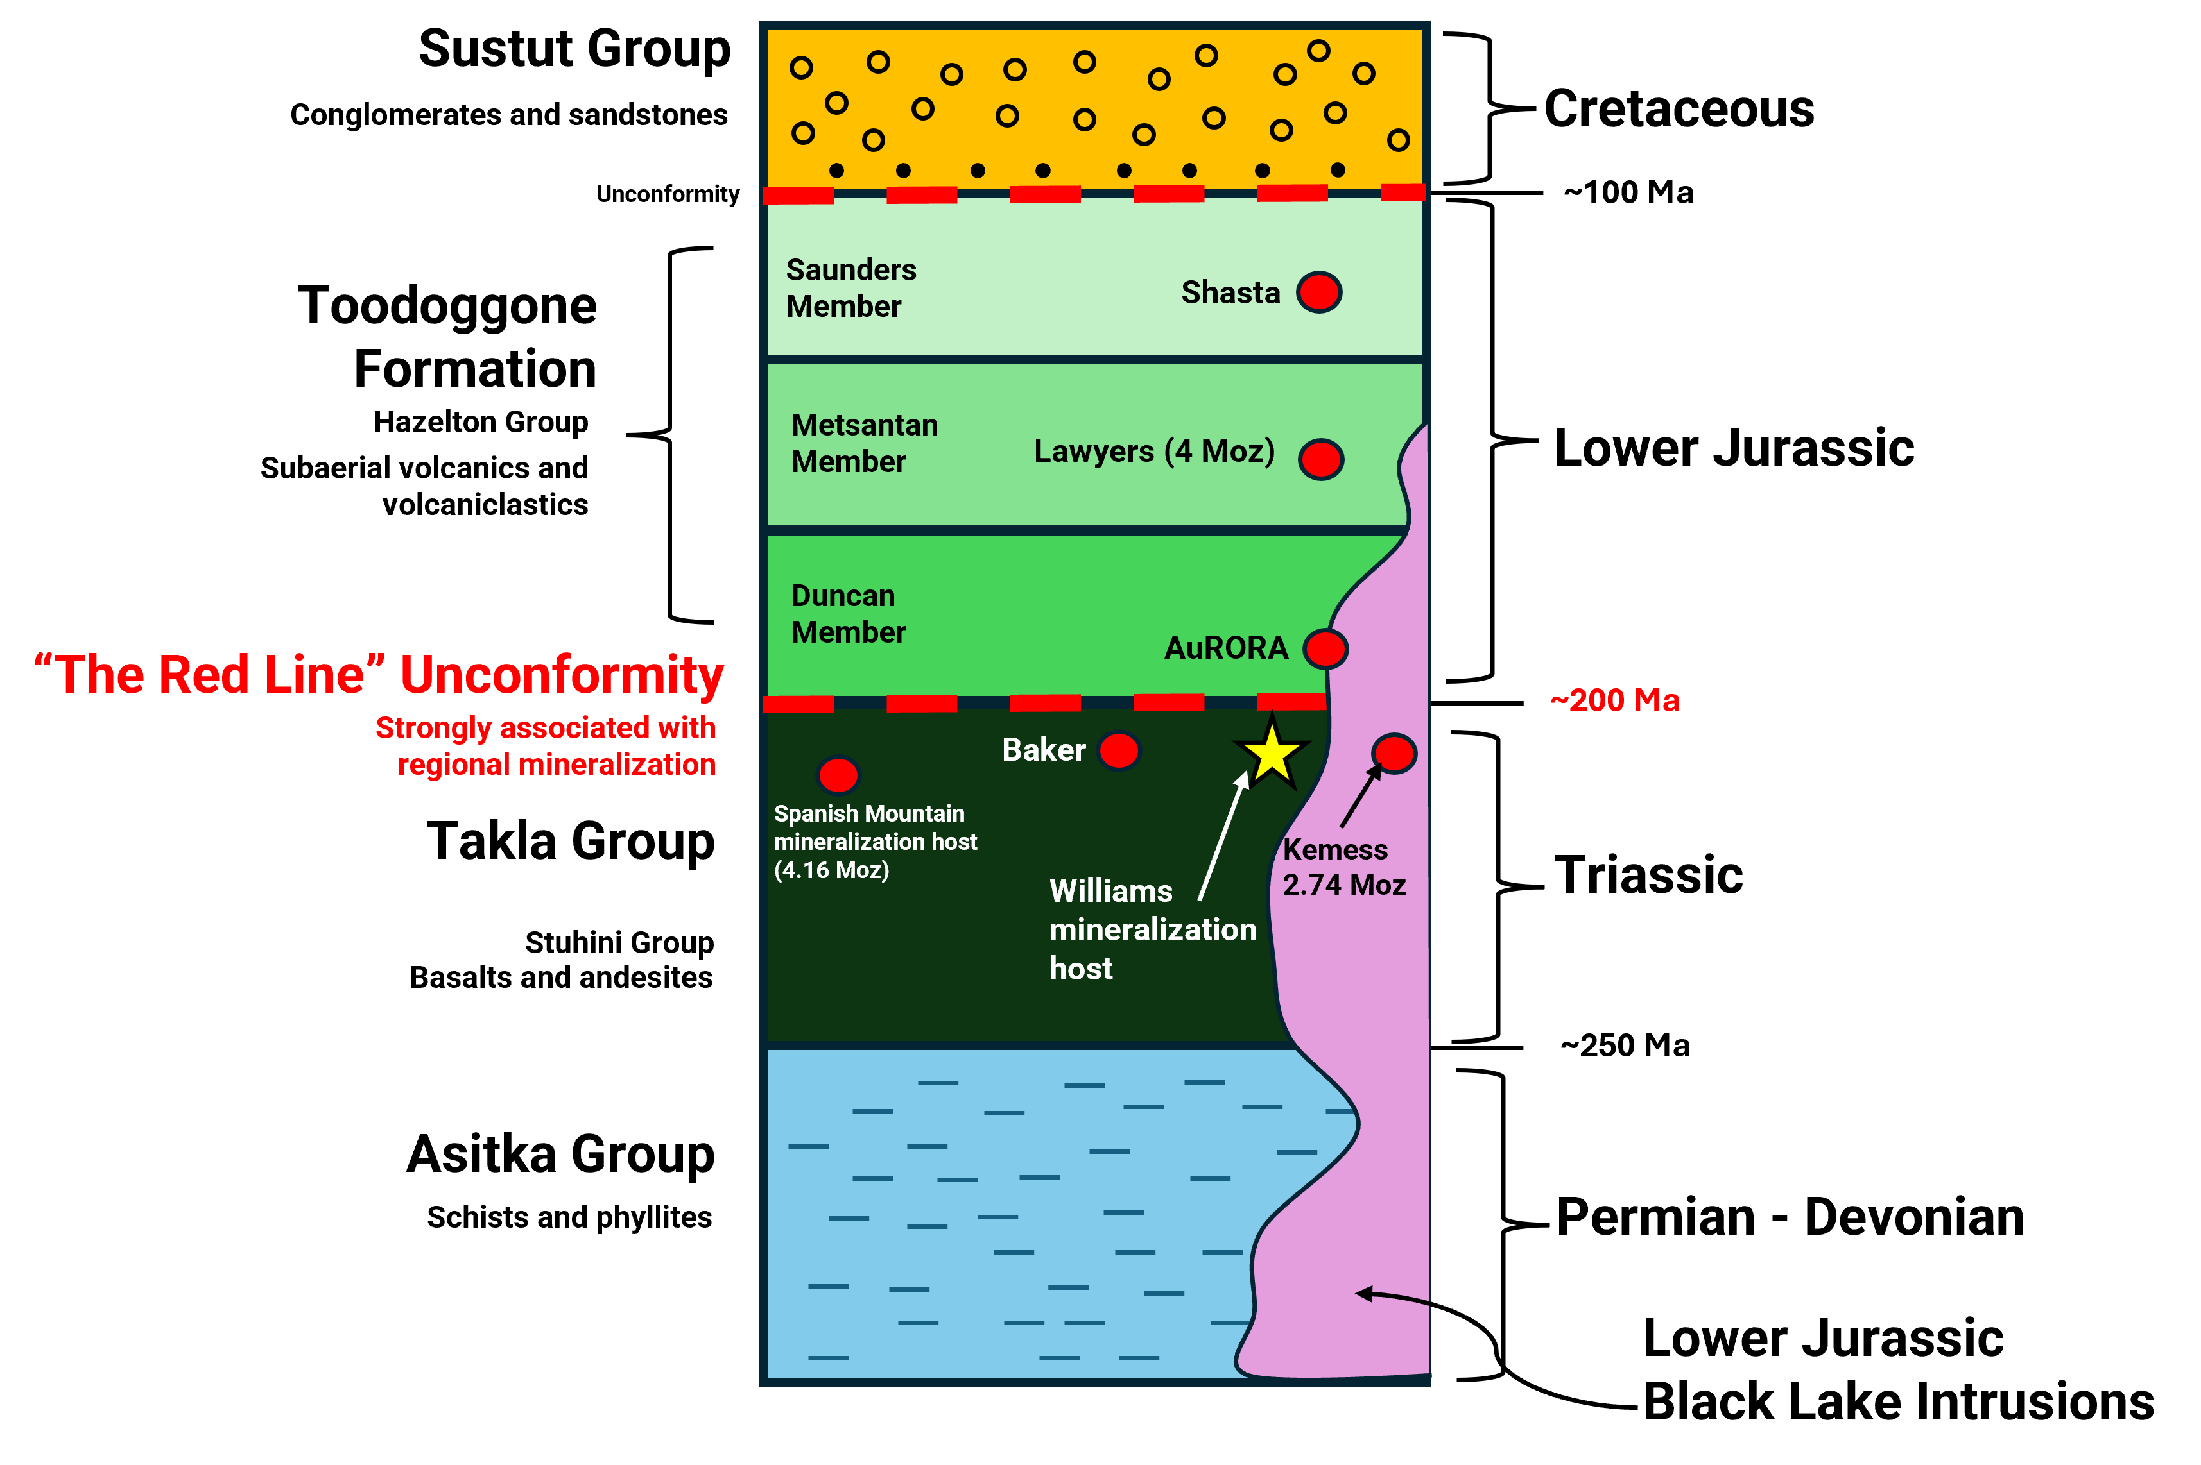
GIC Geology
GIC Mineralization Style
  Orogenic-style gold mineralization
  Age and setting proximal to other prolific deposits within Golden Horseshoe.
  Hosted in basaltic andesites of Triassic aged Takla (Stuhini) Group.
  Takla volcanics are intruded by monzonites and diorites assigned to the Black Lake suite.
  Both stratigraphy and structure appear to be an important control on mineralization.
  The Red Line
    Highly prospective stratigraphic contact zone known to host major gold and copper-gold deposits in British Columbia.
    This key traceable geologic marker spans across the Stikine Terrane of northern BC, encompassing the Golden Triangle and Toodoggone Region.
    Guides exploration toward major mineralized porphyry and epithermal systems.
Generalized Stratigraphic Column of the Golden Horseshoe and Williams Project
10

Slide 11
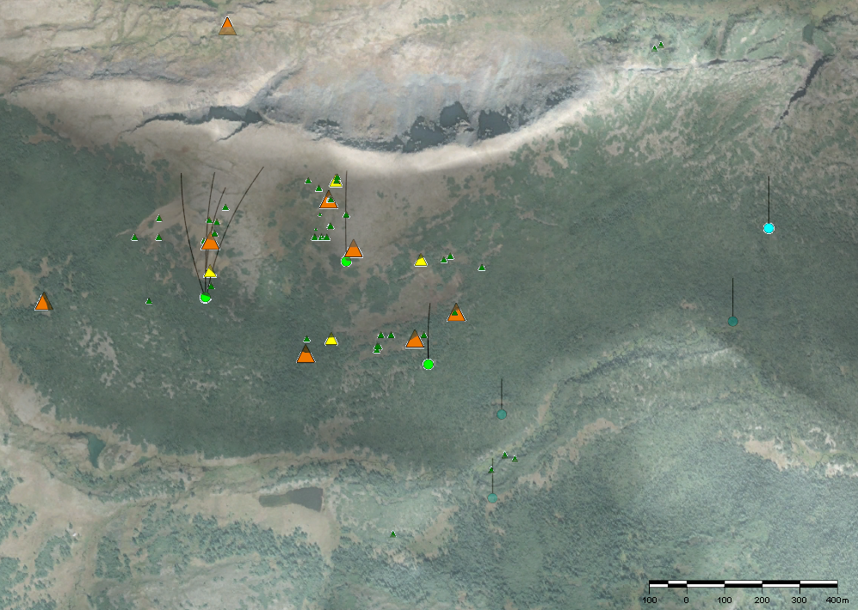
GIC Orogenic Style High Grade Gold
Rock Sample GO90175
1.29 g/t Au
WM24-01
  1.69 g/t Au over 104.08 m
  Incl. 6.22 g/t Au over 18.98 m
WM24-02
  1.33 g/t Au over 28.24 m
  1.09 g/t Au over 57.98 m
WM22-02 (ext.)
  2.16 g/t Au over 96.92m
WM24-03
  1.48 g/t Au over 37 m
  incl. 2.99 g/t Au over 11.25 m
WM24-02
Rock Sample D703623
3.21 wt. % Cu
Rock Sample GO90175
1.29 g/t Au
Sample D703623
1.25 wt. % Cu
WM24-03
WM22-02 ext.
Soil Sample ARC L7
1 g/t Au
Rock Sample 51070
2.96 g/t Au
WM24-01
750 m strike drill confirmed strike
Mineralized mafic package
Rock Sample SS0913-1
3.66 g/t Au
Mineralized mafic package
WM22-03
750 m drill confirmed strike
Cu Rock Grab Samples (wt %)
750 m drill confirmed strike
< 0.01 (not shown)
0.01-0.05
0.05-0.10
0.10-0.50
0.50-1.00
> 1.00
1995 Soil Geochemistry Heat Map (Au – ppm)
Diamond Drill Collars
  2022, 2024 drilling
  2006 drilling
Au Rock Grab Samples (ppm)
GIC 1800m soil anomaly
Bulk-tonnage mineralization
Localized high grade
Three distinct zones
Open in all directions
< 0.01 (not shown)
0.1-0.5
0.5-1.0
1.0-5.0
5.0-10
> 10
Diamond Drill Collars
  2022, 2024 drilling
  2006 drilling
11

Slide 12
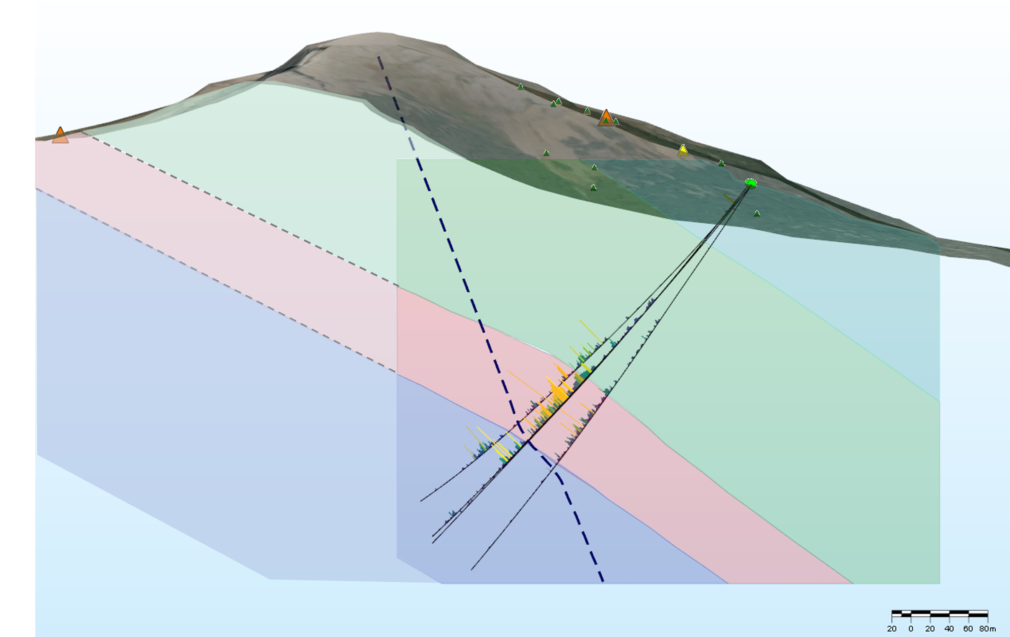
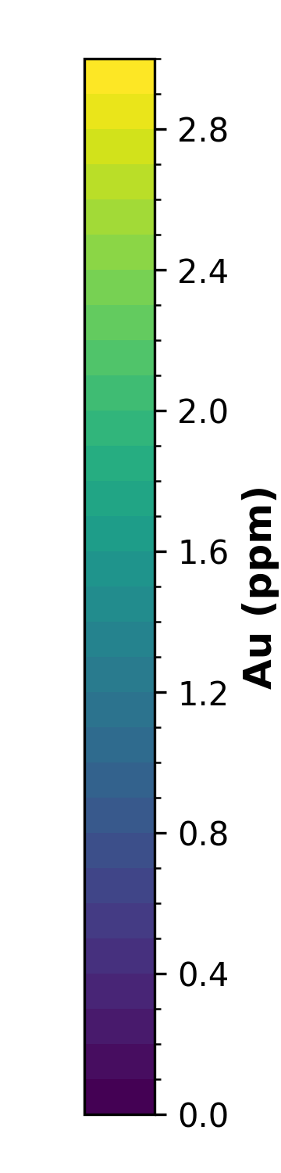
GIC Orogenic Style High Grade Gold
Rock Sample GO90175
1.29 g/t Au
Modelled Fault
Main body of gold mineralization occurs in a structural-stratigraphic package of mafic volcanics and volcaniclastics.
2022 and 2024 drilling revealed high grade Au mineralization within Takla volcanics
Coincident Au soil (up to 1+ g/t) and potentially related IP chargeability anomalies.
Potential for related up-dip Au mineralization
Mineralized mafic package
Variably silicified volcanics and breccias
WM24-02
WM22-02 ext.
Intermediate – mafic volcanics and volcaniclastics
WM24-01
WM22-02 ext.
96.92 m at 2.16 g/t Au
Mafic volcanics and volcaniclastics
Cross section view of 2024 drilling within preliminary stratigraphy and structural model at GIC. Looking East
12

Slide 13
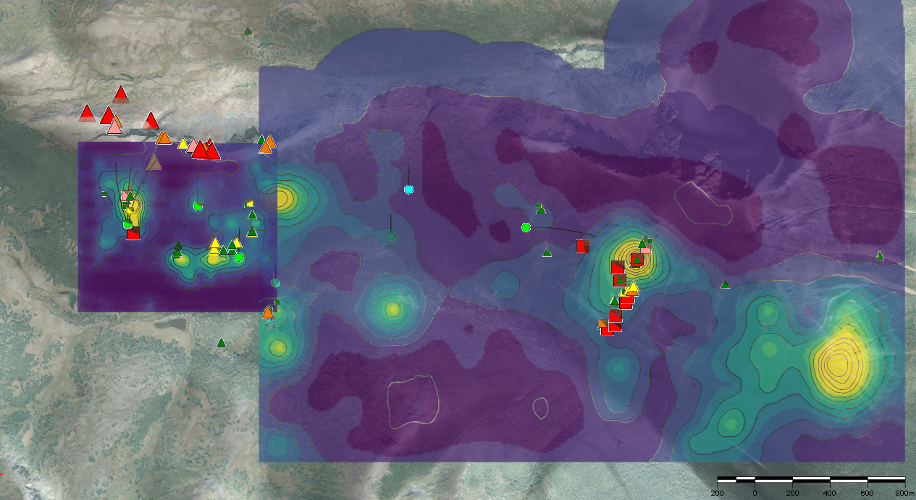
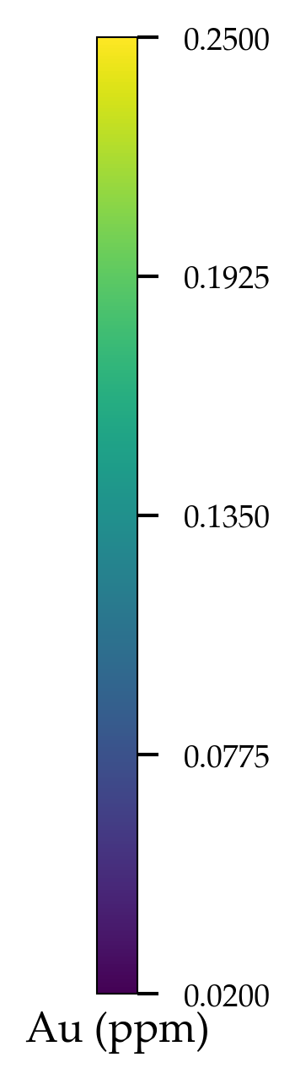
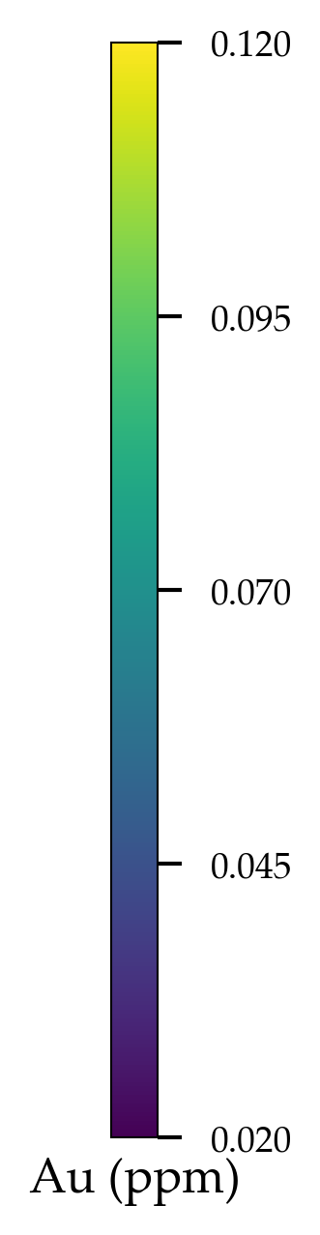
ROI Porphyry Prospect
GIC
WM22-04
ROI
1.5 km
Mineralized mafic package
1800m Au soil anomaly
MoRock Grab Samples (ppm)
Cu Rock Grab Samples (wt %)
Multi km scale soil & CU-Mo rock anomalies – untested targets
< 20 (not shown)
0.01-0.05
0.05-0.10
0.10-0.50
0.50-1.00
> 1.00
< 0.01 (not shown)
0.01-0.05
0.05-0.10
0.10-0.50
0.50-1.00
> 1.00
Diamond Drill Collars
  2022, 2024 drilling
  2006 drilling
1995
2021
13

Slide 14
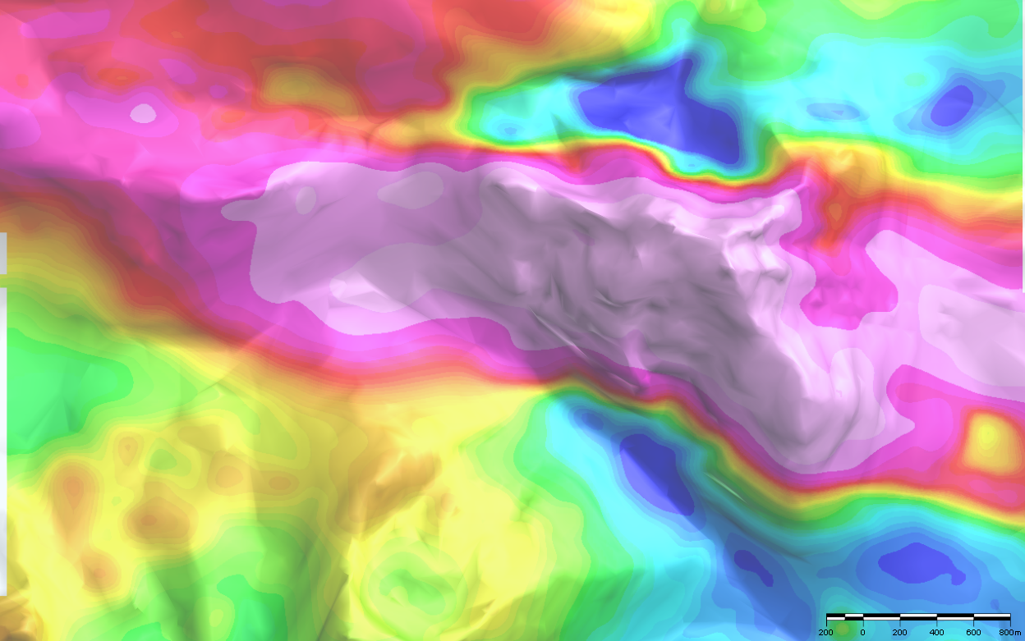

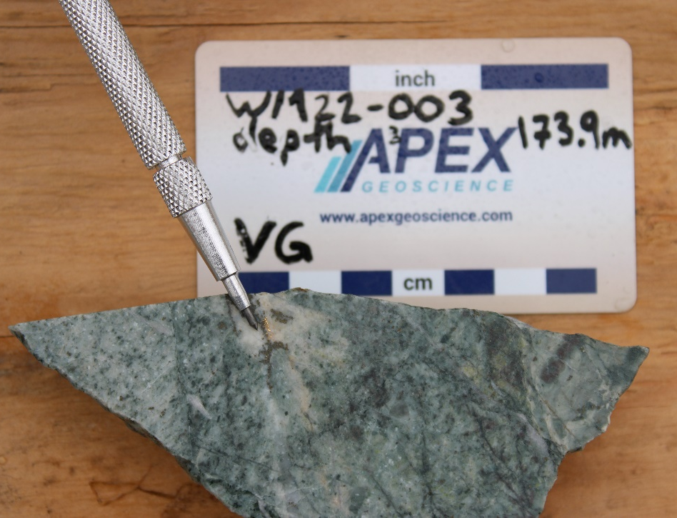
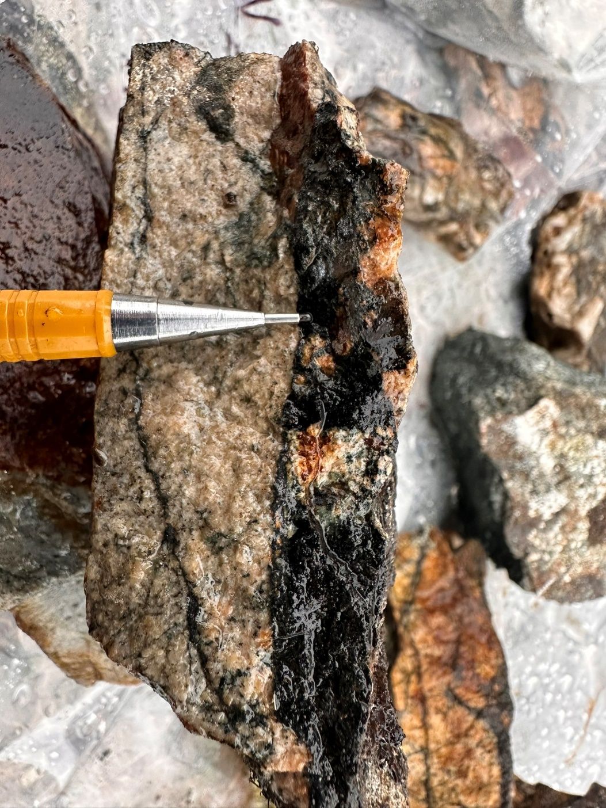
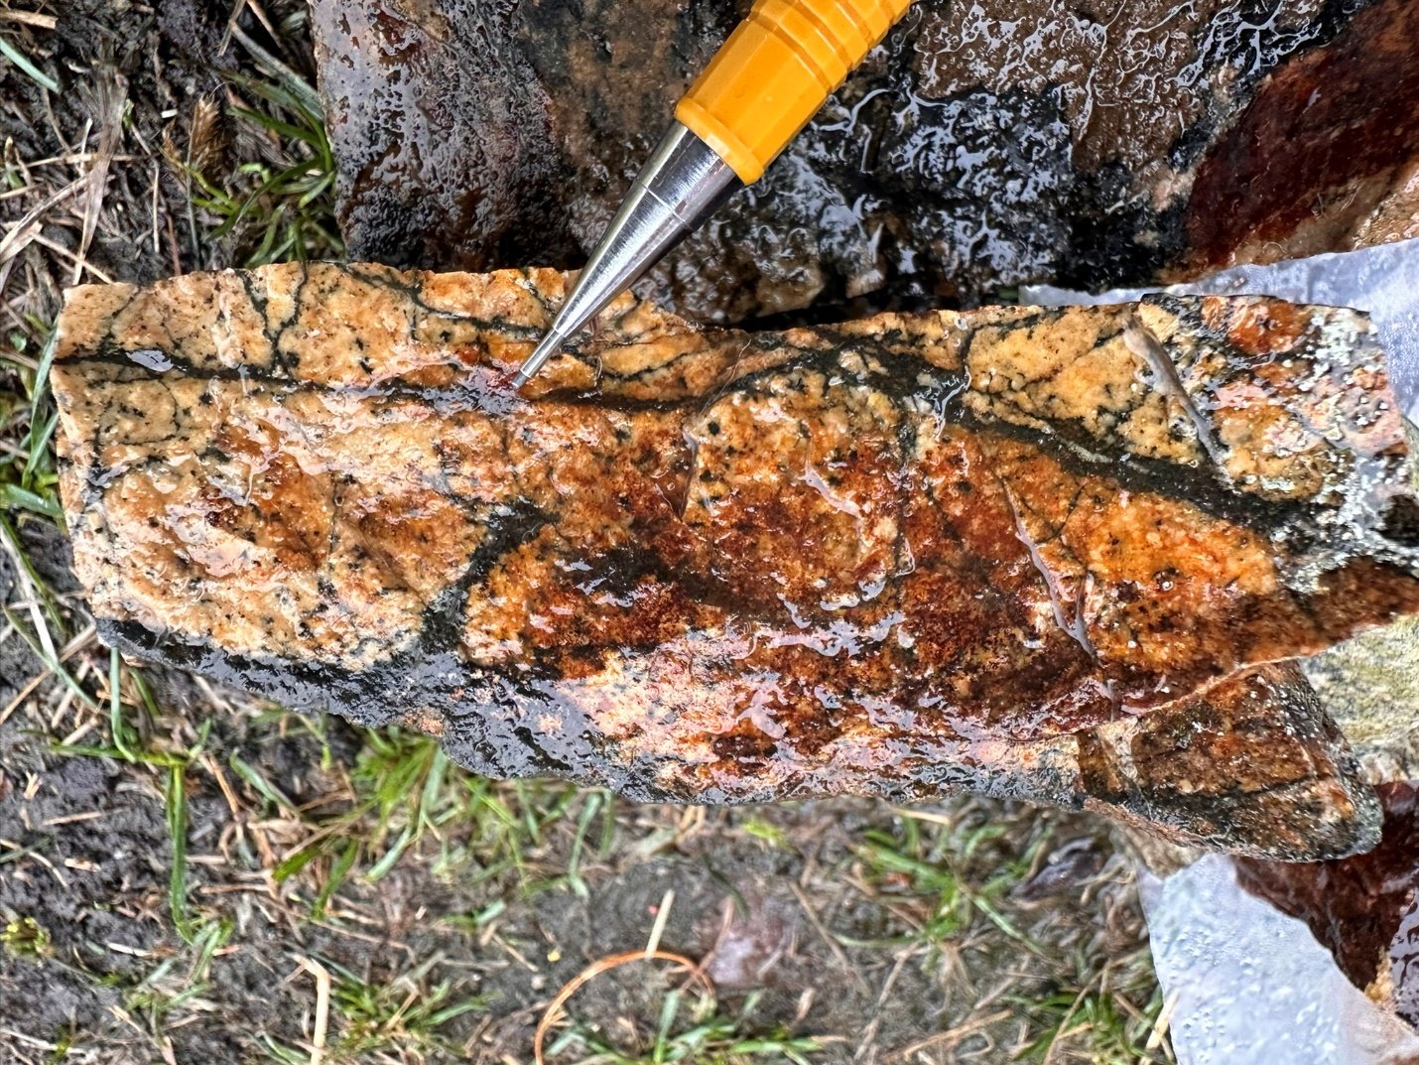
GIC – ROI Relationship
Two Adjacent Mineralization Styles
2024 Drill Holes
GIC
2024 Gold Discovery
Bulk tonnage gold with high grade zones
Orogenic style mineralization
750 m drill verified strike
1800 m Au soil anomaly
Open in all directions
ROI
~2 km east of GIC
3.5 km porphyry geophysical anomaly
Compelling Cu, soil and rock sampling
GIC 1,800 m Gold Target
ROI
GIC
3.5 km magnetic high
WM22-03
4.64 g/t Au over 8m
Stockwork magnetite veining in monzonite
14

Slide 15
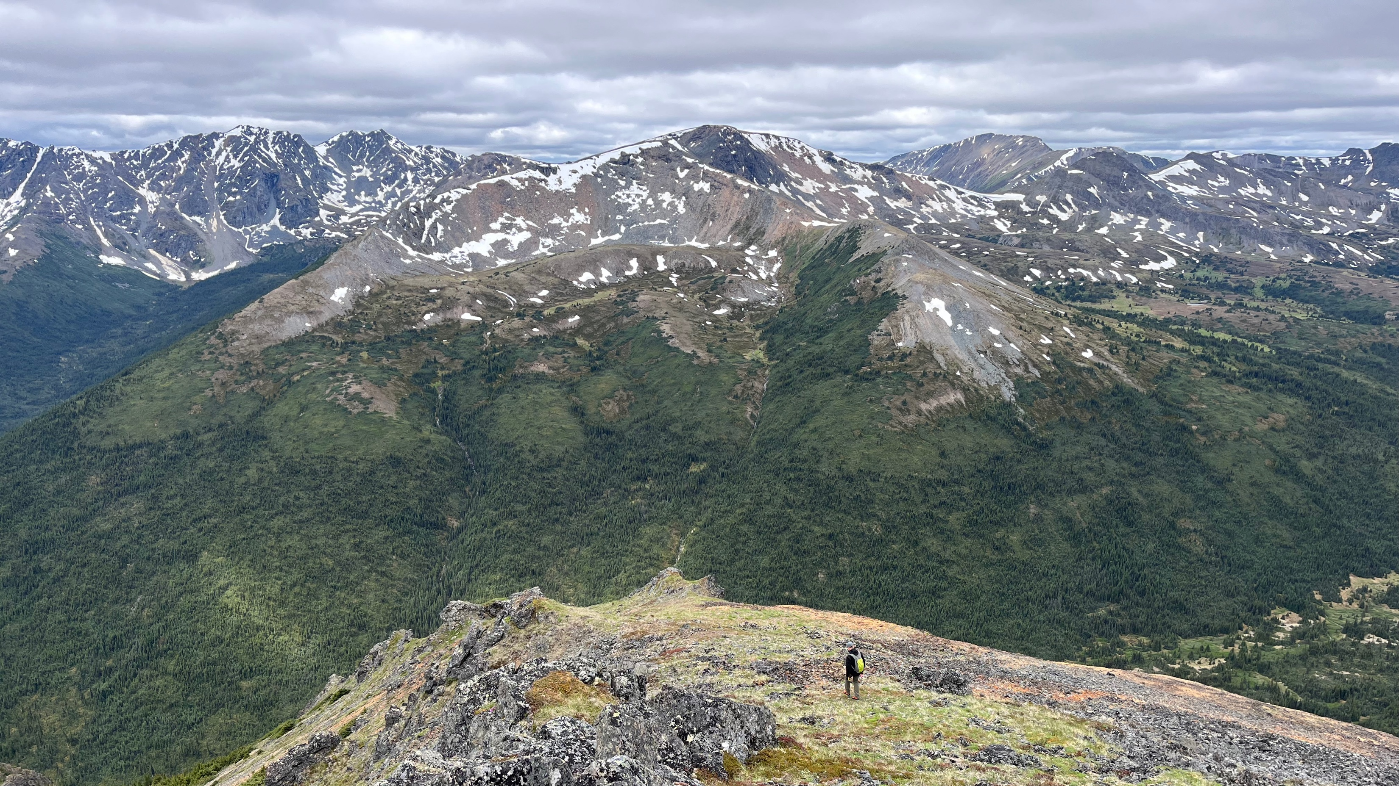
2026 Strategy
Focus at GIC
Cost effective exploration
Advance GIC Gold Zone bulk tonnage discovery:
Up to 5,000 m staged drill program
Focus on 750 m drill confirmed strike length
Near surface targets
Preliminary exploration at ROI porphyry anomaly
15

Slide 16
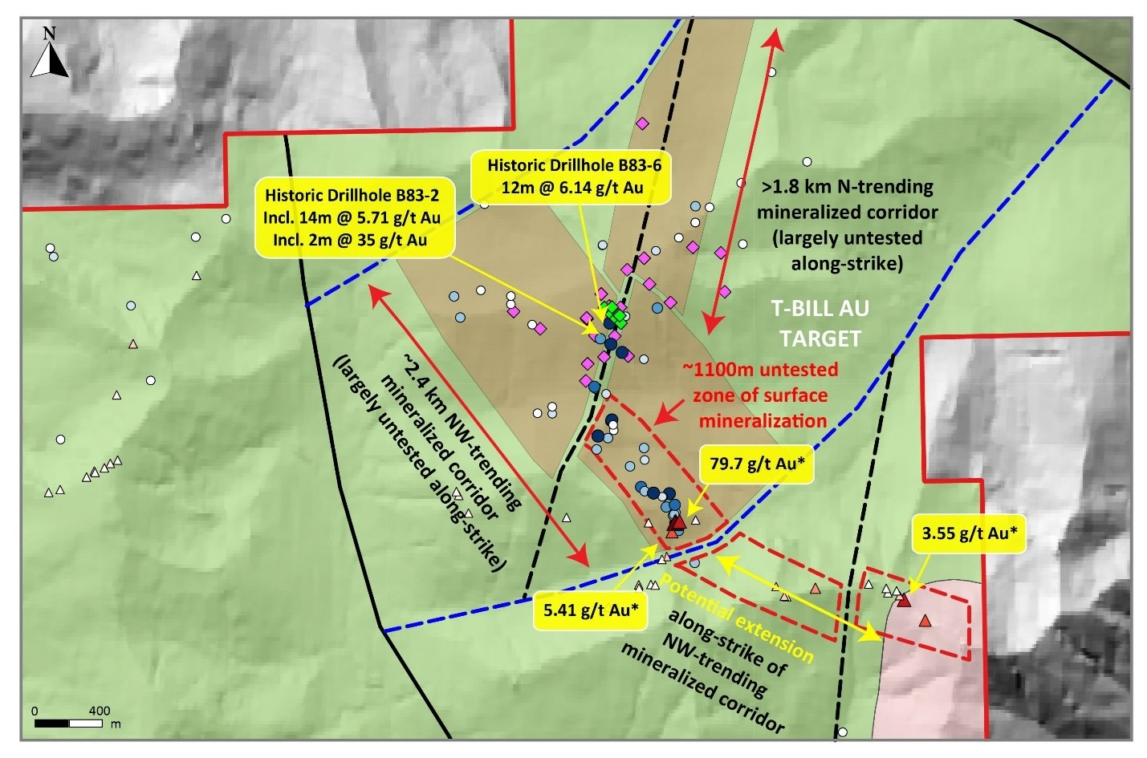
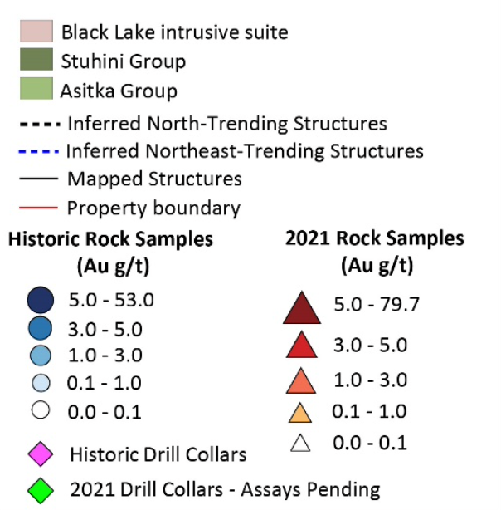
T-Bill
  3 km x 2.5 km high-grade epithermal mineralization hosted in quartz veins and breccias​
​​
  Historic 2021 drill program highlights: 1.38 g/t Au over 41.57 m (WM21-07)
  Multi-km extension potential
  Drilling tested only ~300 m strike length of primary anomaly
  High-grade surface samples
  * select historic grab rock samples
Historic Drillhold WM21-07
21.7 g/t Au*
22 g/t Au*
16

Slide 17
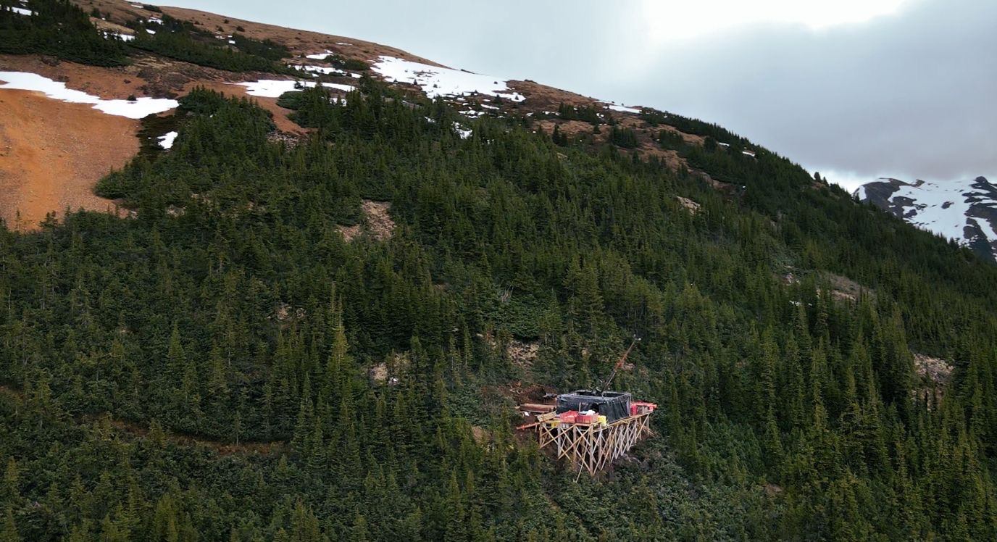
Why Invest
Team
Technical team with notable resource discovery and development successes.
Expertise
Deep understanding of Toodoggone geology and resource development.
Location
Toodoggone District has exceptional mineral endowment, surging with exploration and development.
Gold Discovery
Bulk tonnage Au discovery, high grade zones, multimillion ounce potential & additional discovery targets.
Structure
49.5M shares outstanding with high management ownership.
17

Slide 18
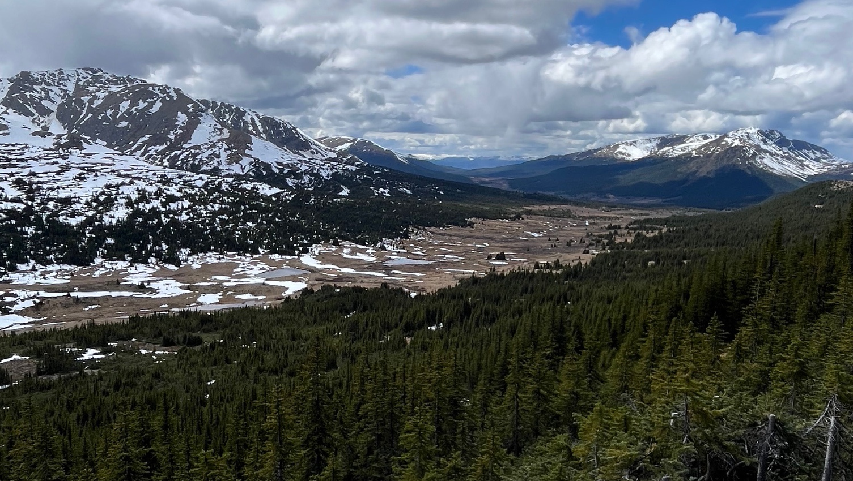
Toodoggone Comparatives
Company | Shares (Millions) | Share Price | MCAP (Millions$) | Key Results (g/t Au/m)
Omega Pacific | 49.50 | $0.17 | 8.42 | 2.16/96.9
Sun Summit | 317.50 | $0.13 | 43.20 | 4.80/81
Hi-View Resources | 44.30 | $0.32 | 14.18 | N/A
TDG Gold | 279.81 | $0.62 | 171.24 | 1.23/240.6
Finlay Minerals | 169.90 | $0.11 | 18.69 | 1% Cu; 0.05/162
Amarc | 225.33 | $0.95 | 214.11 | 1.87/132
Prospect Ridge | 113.84 | $0.06 | 6.83 | N/A
Thesis Gold | 278.46 | $3.27 | 906.45 | 4.53/60
Evergold | 22.78 | $0.59 | 13.44 | N/A
May 5, 2026
13
18

Slide 19
CSE: OMGA | OTCQB: OMGPF | FSE: Q0F
Jason Leikam CEO | T:778.858.8085 | jason@omegapacific.ca

